Slide 1
Find the greatest of 3 numbers?

Slide 2
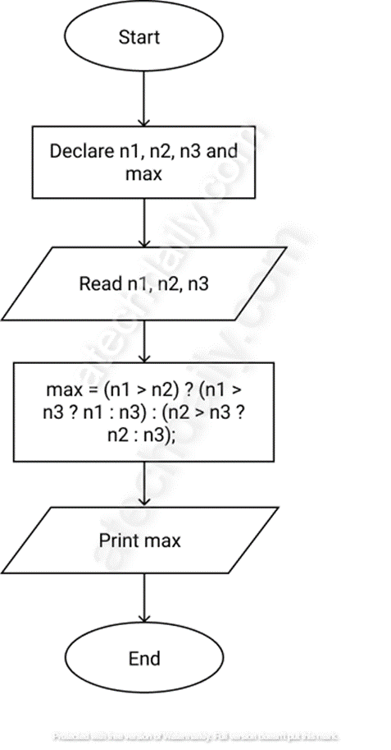
Flowchart for Largest of three numbers:

Slide 3
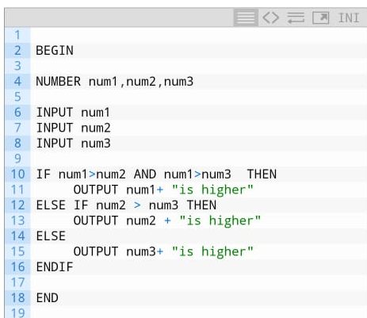
Pseudocode

